Slide 1


ACCT 2003F Intermediate Financial Accounting 中级财务会计
授课人: 墙伟
THE HITSZ
SCHOOL OF ECONOMICS
AND MANAGEMENT
2024.8.26

Slide 2

Ph.D. (Accounting) Assistant Professor School of Economics and Management Email:qiangwei311@hit.edu.cn Office: M512 Web: http://faculty.hitsz.edu.cn/qiangwei Research: Capital Market Research in Accounting and Auditing Teaching: Harbin Institute of Technology, Shenzhen Intermediate Financial Accounting (BBA) Empirical Research Methodology of Accounting (Master) Frontiers of Accounting and Academic Research (Master) Lingnan University, Hong Kong Managerial Accounting (BBA) Advanced Auditing (MAcc) Intermediate Accounting (MAcc) Accounting (MAcc) Nanyang Technological University, Singapore Accounting (BBA, Tutor)
QIANG, Wei 墙 伟

Slide 3

QQ 课程群

Slide 4
Course Objectives
After successfully completing this course , you should be able to:
Understand the conceptual framework for financial reporting , the basic assumptions of accounting, and the basic principles of accounting recognition and measurements;
Analyze the impact of various economic transactions on accounting equations;
Use specific principles of accounting recognition and measurement to record in the accounting information system;
Prepare financial reporting including income statement, statement of financial position, statement of cash flows, and their related disclosures.

Slide 5
Course Structure
 | LECTURE 授课 | LAB ERP 实验
Credit hours 学时 | 52 hours | 12 hours
Venue 地点 | T3502 (周一)/(周三) | 待定
Time 时间 | Monday: 18:45-20:30 Wednesday: 18:45-20:30 W1 – W15 (W6&7 Except) | W7, W14-W16

Slide 6
Course Assessment
考核环节 | 所占分值(%) | 考核与评价细则
实验 | 20 | 学生分组按要求完成1个会计项目实验报告。实验指导老师根据学生实验报告和个人在ERP系统中完成情况给出综合评价。
期中考试（闭卷） | 30 | 考试采用闭卷形式，考试内容覆盖课程大纲编号第1至4部分教学内容，考试题型包含选择题、简答题和会计账务处理。
期末考试（闭卷） | 50 | 考试采用闭卷形式，考试内容覆盖课程大纲全部教学内容，考试题型包含简答题、会计账务处理及报表编制。

Slide 7


Textbook
中级会计学 基于IFRS 第2版
唐纳德·基索，杰里·韦安特， 特里·沃菲尔, 2018

Slide 8
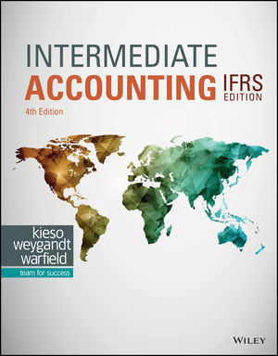
Textbook
Intermediate Accounting I F R S Edition
Kieso, Weygandt, Warfield
Fourth Edition, 2020

Slide 9

LEARNING OBJECTIVES
CHAPTER 1
Financial Reporting
and Accounting Standards
After studying this chapter, you should be able to:
Describe the growing importance of global financial markets and its relation to financial reporting.
Identify the major policy-setting bodies and their role in the standard-setting process.

Slide 10
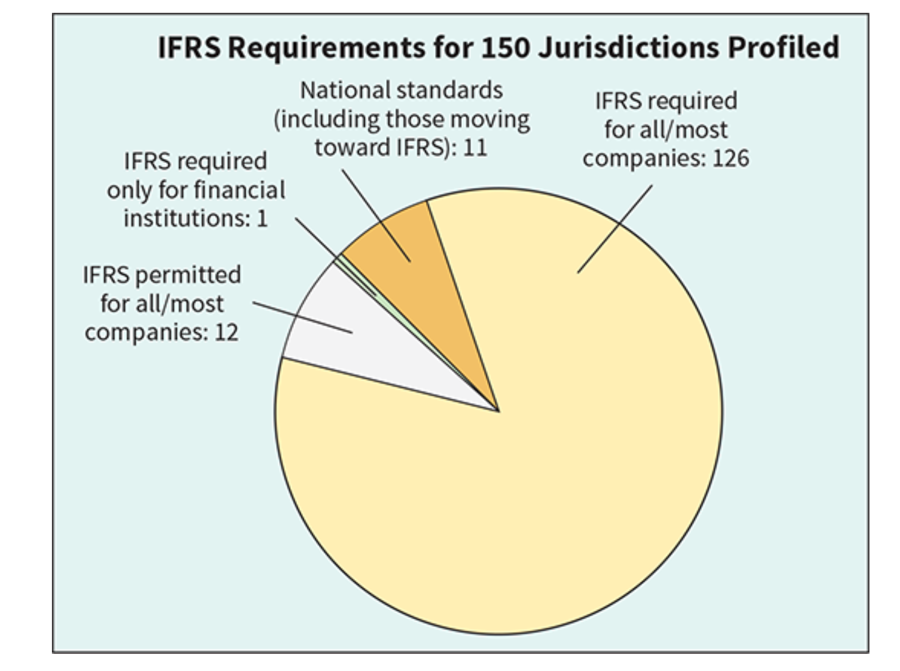
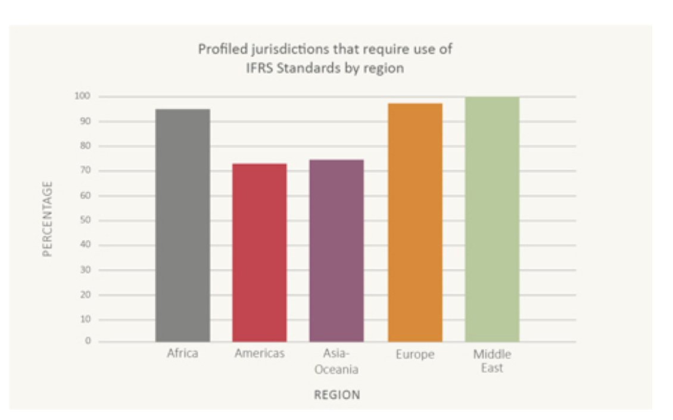
Continuing Evolution of International Financial Reporting
https://www.ifrs.org/use-around-the-world/why-global-accounting-standards/
Notes:
https://www.ifrs.org/use-around-the-world/why-global-accounting-standards/ Video broadcast here!!!
IFRS was successful in creating a common accounting language for capital markets (European Commission, 2015).
Evidence suggests that IFRS adoption was largely positive for listed companies in Australia (Australian Accounting Standards Board, 2016).
IFRS adoption helped to reduce investment risk in domestic firms, mitigate the “Korea discount,” and attract foreign capital via overseas shares listing, bond issuance, or mergers and acquisitions (Korean Accounting Standards Board, 2016).

Slide 11
Describe the global financial markets and their relation to financial reporting.
Learning Objective 1

Slide 12
Global Markets
World markets are becoming increasingly intertwined.
Top 20 Global Companies In Terms of Sales
排名 | 公司名称(中文) | 营业收入(百万美元) | 利润(百万美元) | 国家
1 | 沃尔玛（WALMART) | 648,125 | 15,511 | 美国
2 | 亚马逊（AMAZON.COM) | 574,785 | 30,425 | 美国
3 | 国家电网有限公司（STATE GRID) | 545,947.5 | 9,204.3 | 中国
4 | 沙特阿美公司（SAUDI ARAMCO) | 494,890.1 | 120,699.3 | 沙特阿拉伯
5 | 中国石油化工集团有限公司（SINOPEC GROUP) | 429,699.7 | 9,393.4 | 中国
6 | 中国石油天然气集团有限公司（CHINA NATIONAL PETROLEUM) | 421,713.6 | 21,294.7 | 中国
7 | 苹果公司（APPLE) | 383,285 | 96,995 | 美国
8 | 联合健康集团（UNITEDHEALTH GROUP) | 371,622 | 22,381 | 美国
9 | 伯克希尔－哈撒韦公司（BERKSHIRE HATHAWAY) | 364,482 | 96,223 | 美国
10 | CVS Health公司（CVS HEALTH) | 357,776 | 8,344 | 美国
排名 | 公司名称(中文) | 营业收入(百万美元) | 利润(百万美元) | 国家
11 | 大众公司（VOLKSWAGEN) | 348,408.1 | 17,944.5 | 德国
12 | 埃克森美孚（EXXON MOBIL) | 344,582 | 36,010 | 美国
13 | 壳牌公司（SHELL) | 323,183 | 19,359 | 英国
14 | 中国建筑集团有限公司（CHINA STATE CONSTRUCTION ENGINEERING) | 320,430.5 | 4,371.5 | 中国
15 | 丰田汽车公司（TOYOTA MOTOR) | 312,018.2 | 34,214.4 | 日本
16 | 麦克森公司（MCKESSON) | 308,951 | 3,002 | 美国
17 | Alphabet公司（ALPHABET) | 307,394 | 73,795 | 美国
18 | Cencora公司（CENCORA) | 262,173.4 | 1,745.3 | 美国
19 | 托克集团（TRAFIGURA GROUP) | 244,280.2 | 7,393.2 | 新加坡
20 | 开市客（COSTCO WHOLESALE) | 242,290 | 6,292 | 美国
ILLUSTRATION 1.1
LO 1
Notes:
To provide some indication of the extent of globalization of economic activity, Illustration 1.1 provides a listing of the top 20 global companies in terms of sales.
The tremendous variety and volume of both exported and imported goods indicates the extensive involvement in international trade—for many companies, the world is their market.

Slide 13
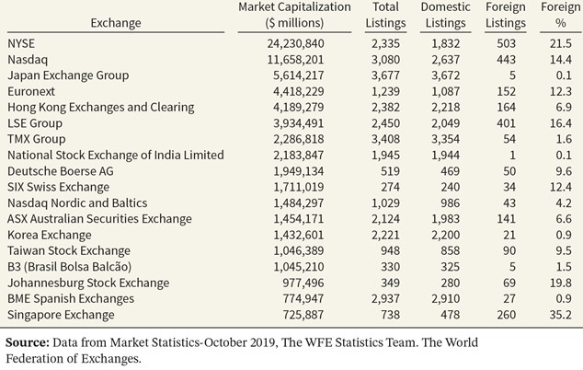
Global Markets
Significant number of foreign companies are found on national exchanges.
ILLUSTRATION 1.2
International Exchange Statistics
LO 1
Notes:
an indication of the significance of these international investment opportunities can be found when examining the number of foreign registrations on various securities exchanges.

Slide 14
沪股通和深股通 (北向, HKEX)
HKEX 持股记录 A 股 TOP 10 （截止2023年8月26日）
股份代号 | 股份名称 | 于中央结算系统的持股量 | 占于上交所上市及交易的A股总数的百分比
90885 | 宏发股份 | 241,530,369 | 23.16%
93605 | 珀莱雅 | 79,295,803 | 20.12%
90660 | 福耀玻璃 | 402,019,065 | 20.07%
90406 | 国电南瑞 | 1,407,950,124 | 17.66%
30187 | 时代电气 | 35,128,690 | 16.63%
93939 | 益丰药房 | 161,413,522 | 16.04%
91901 | 方正证券 | 1,277,585,274 | 15.51%
90887 | 伊利股份 | 925,576,815 | 14.74%
90176 | 中国巨石 | 573,935,364 | 14.33%
90570 | 恒生电子 | 271,249,866 | 14.27%
90066 | 宇通客车 | 311,677,550 | 14.07%
91100 | 恒立液压 | 179,782,420 | 13.40%
93713 | 密尔克卫 | 21,144,403 | 12.92%
91615 | 明阳智能 | 258,175,594 | 12.24%
93882 | 金域医学 | 56,542,784 | 12.18%
90803 | 新奥股份 | 168,623,084 | 11.53%
90563 | 法拉电子 | 25,485,011 | 11.32%
90835 | 上海机电 | 90,409,489 | 11.21%

Slide 15
沪股通和深股通 (北向, HKEX)
深股通成交活跃股 (仅包含A股) TOP10
排名 | 股票代码 | 名称 | 买入金额 (RMB mil) | 卖出金额 (RMB mil) | 买入及卖出金额（RMB Mil)
1 | 300750 | 宁德时代 | 15,503.97 | 8,966.46 | 24,470.43
2 | 2594 | 比亚迪 | 11,621.24 | 7,522.87 | 19,144.11
3 | 858 | 五粮液 | 9,827.12 | 7,306.81 | 17,133.93
4 | 300308 | 中际旭创 | 8,549.84 | 7,283.37 | 15,833.21
5 | 2475 | 立讯精密 | 6,459.65 | 8,502.85 | 14,962.50
6 | 63 | 中兴通讯 | 7,937.39 | 6,185.11 | 14,122.50
7 | 300059 | 东方财富 | 7,739.75 | 5,729.92 | 13,469.67
8 | 977 | 浪潮信息 | 6,770.60 | 6,585.00 | 13,355.60
9 | 2230 | 科大讯飞 | 5,322.50 | 5,628.89 | 10,951.39
10 | 625 | 长安汽车 | 5,585.00 | 4,966.83 | 10,551.83

Slide 16
沪股通和深股通 (北向, HKEX)
沪股通成交活跃股 (仅包含A股) TOP10
排名 | 股票代码 | 名称 | 买入金额 (RMB mil) | 卖出金额 (RMB mil) | 买入及卖出金额（RMB Mil)
1 | 600519 | 贵州茅台 | 19,953.18 | 11,755.12 | 31,708.30
2 | 601138 | 工业富联 | 9,372.12 | 7,868.58 | 17,240.70
3 | 601012 | 隆基绿能 | 7,512.29 | 9,337.94 | 16,850.23
4 | 601888 | 中国中免 | 6,966.23 | 7,547.27 | 14,513.50
5 | 601318 | 中国平安 | 6,906.72 | 5,713.95 | 12,620.67
6 | 600036 | 招商银行 | 5,475.96 | 5,817.02 | 11,292.98
7 | 600809 | 山西汾酒 | 4,976.76 | 6,132.57 | 11,109.33
8 | 600570 | 恒生电子 | 4,241.22 | 4,625.19 | 8,866.41
9 | 600030 | 中信证券 | 5,249.45 | 3,340.71 | 8,590.16
10 | 601601 | 中国太保 | 3,464.61 | 4,756.77 | 8,221.38

Slide 17
Global Markets
Financial Statements and Financial Reporting
Essential characteristics of accounting are:
the identification, measurement, and communication of financial information about
economic entities to
interested parties.
LO 1
Notes:
What is Accounting?
Financial accounting is the process that culminates in the preparation of financial reports on the enterprise for use by both internal and external parties. Users of these financial reports include investors, creditors, managers, unions, and government agencies.
managerial accounting is the process of identifying, measuring, analyzing, and communicating financial information needed by management to plan, control, and evaluate a company’s operations.
The financial statements most frequently provided are (1) the statement of financial position, (2) the income statement (or statement of comprehensive income), (3) the statement of cash flows, and (4) the statement of changes in equity.

Slide 18
Global Markets
Economic Entity
Financial Statements
Additional Information
Financial Information
Accounting?
Identify
and
Measure
and
Communicate
Statement of Financial Position
Income Statement or Statement of Comprehensive Income
Statement of Cash Flows
Statement of Changes in Equity
Note Disclosures
President’s letter
Prospectuses
Reports filed with governmental agencies
News releases
Forecasts
Environmental impact statements
Etc.
LO 1

Slide 19
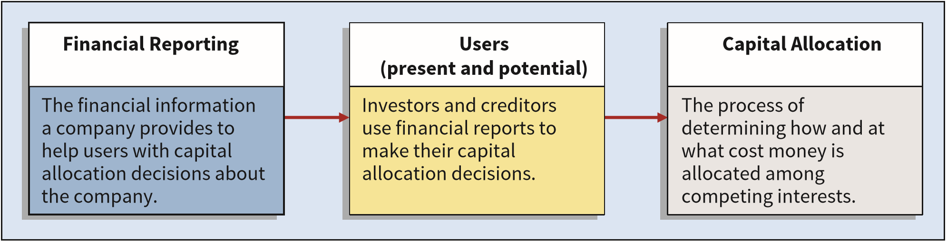
Global Markets
Accounting and Capital Allocation
Resources are limited. Efficient use of resources often determines whether a business thrives.
ILLUSTRATION 1.3 Capital Allocation Process
LO 1
Notes:
Accountants must measure performance accurately and fairly on a timely basis, so that the right managers and companies are able to attract investment capital.
An effective process of capital allocation is critical to a healthy economy. It promotes productivity, encourages innovation, and provides an efficient and liquid market for buying and selling securities and obtaining and granting credit. Unreliable and irrelevant information leads to poor capital allocation, which adversely affects the securities markets.

Slide 20
Global Markets
High Quality Standards
Globalization demands a single set of high-quality international accounting standards. Some elements:
Single set of high-quality accounting standards established by a single standard-setting body.
Consistency in application and interpretation.
Common disclosures.
Common high-quality auditing standards and practices.
Common approach to regulatory review and enforcement.
Education and training of market participants.
(Continued)
LO 1
Notes:
To facilitate efficient capital allocation, investors need relevant information and a faithful representation of that information to enable them to make comparisons across borders.
For example, assume that you were interested in investing in the telecommunications industry. Four of the largest telecommunications companies in the world are Nippon Telegraph and Telephone (JPN), Deutsche Telekom (DEU), Telefonica (ESP and PRT), and AT&T (USA). How do you decide in which of these telecommunications companies to invest, if any?
A single, widely accepted set of high-quality accounting standards is a necessity to ensure adequate comparability.

Slide 21
Global Markets
High Quality Standards
Globalization demands a single set of high-quality international accounting standards. Some elements:
Common delivery systems (e.g., eXtensible Business Reporting Language—XBRL).
Common approach to corporate governance and legal frameworks around the world.
LO 1

Slide 22
Identify the major policy-setting bodies and their role in the standard-setting process.
Learning Objective 2

Slide 23
Standard-Setting Organizations
Main international standard-setting organization:
International Accounting Standards Board (IASB)
Issues International Financial Reporting Standards (IFRS).
Standards used on most foreign exchanges.
IFRS used in over 149 countries.
Two organizations that have a role in international standard-setting are the International Organization of Securities Commissions (IOSCO) and the IASB.
LO 3

Slide 24

Standard-Setting Organizations
International Organization of Securities Commissions (IOSCO)
Does not set accounting standards.
Dedicated to ensuring that global markets can operate in an efficient and effective basis.
Supports the use of IFRS as the single set of international standards in cross-border offerings and listings.
http://www.iosco.org/
LO 3
Notes:
The International Organization of Securities Commissions (IOSCO) is an association of organizations that regulate the world’s securities and futures markets.
Members are generally the main financial regulator for a given country.

Slide 25
Standard-Setting Organizations
International Accounting Standards Board (IASB)
Composed of four organizations—
IFRS Foundation
International Accounting Standards Board (IASB)
IFRS Advisory Council
IFRS Interpretations Committee
LO 3

Slide 26
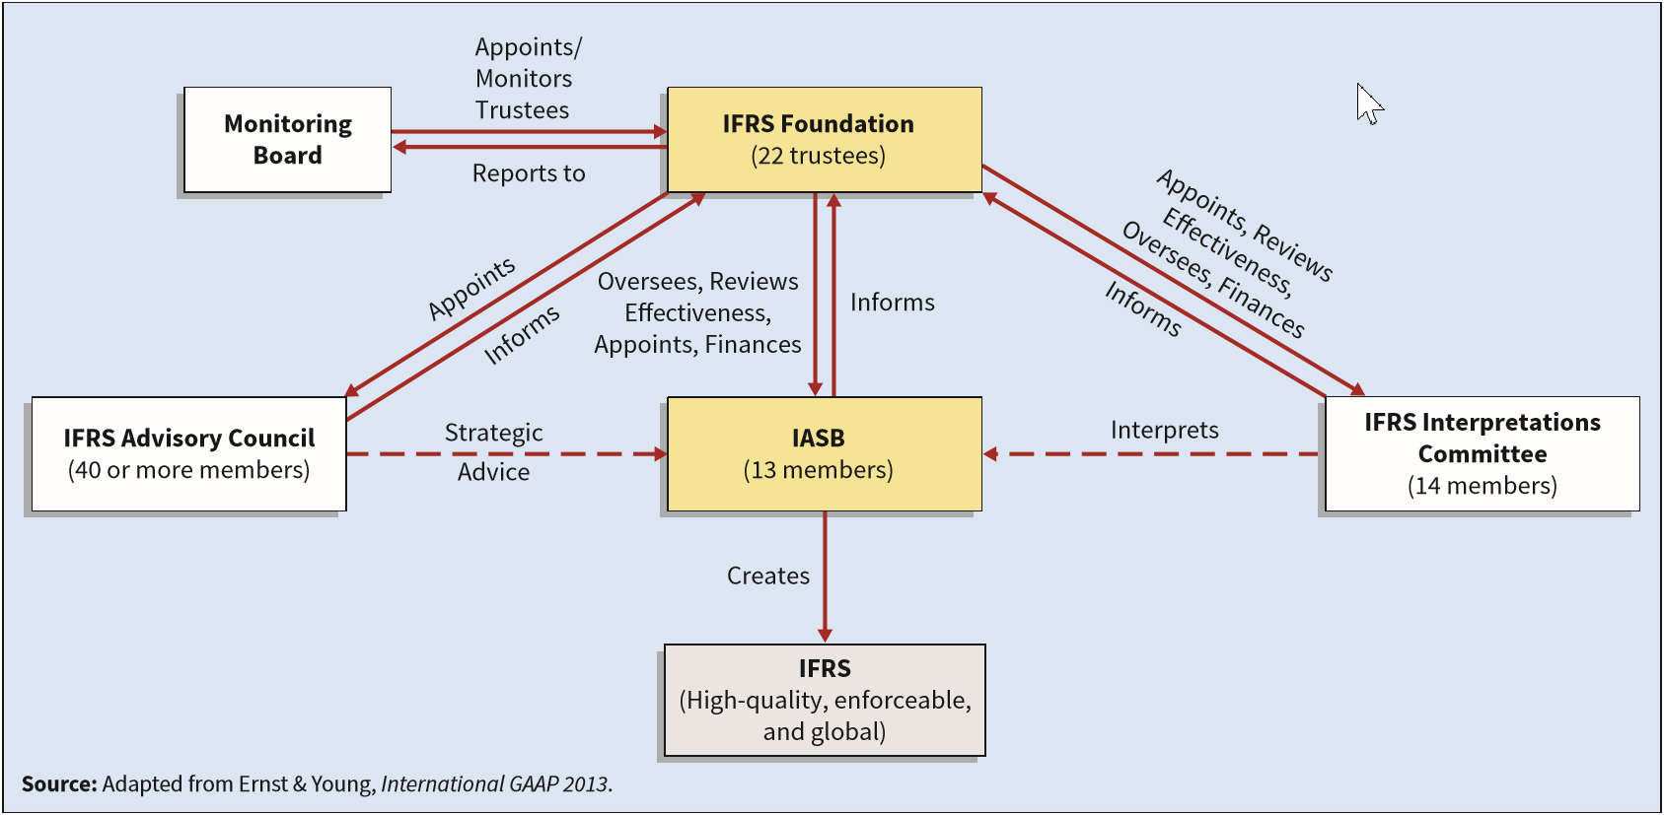
International Accounting Standards Board
ILLUSTRATION 1.4
International Standard-Setting Structure
LO 3
Notes:
The IFRS Foundation provides oversight to the IASB, IFRS Advisory Council, and IFRS Interpretations Committee. In this role, it appoints members, reviews effectiveness, and helps in the fundraising efforts for these organizations.
The International Accounting Standards Board (IASB) develops, in the public interest, a single set of high-quality, enforceable, and global international financial reporting standards for general-purpose financial statements.
The IFRS Advisory Council (the Advisory Council) provides advice and counsel to the IASB on major policies and technical issues.
The IFRS Interpretations Committee assists the IASB through the timely identification, discussion, and resolution of financial reporting issues within the framework of IFRS.

Slide 27

单选题
1分
Question
IFRS stands for:
A
International Federation of Reporting Services.
B
Independent Financial Reporting Standards.
C
International Financial Reporting Standards.
D
Integrated Financial Reporting Services.
Submit

Slide 28
International Accounting Standards Board
Due Process
The IASB due process has the following elements:
Independent standard-setting board;
Thorough and systematic process for developing standards;
Engagement with investors, regulators, business leaders, and the global accountancy profession at every stage of the process; and
Collaborative efforts with the worldwide standard-setting community.
LO 3
Notes:
In establishing financial accounting standards, the IASB has a thorough, open, and transparent due process.

Slide 29
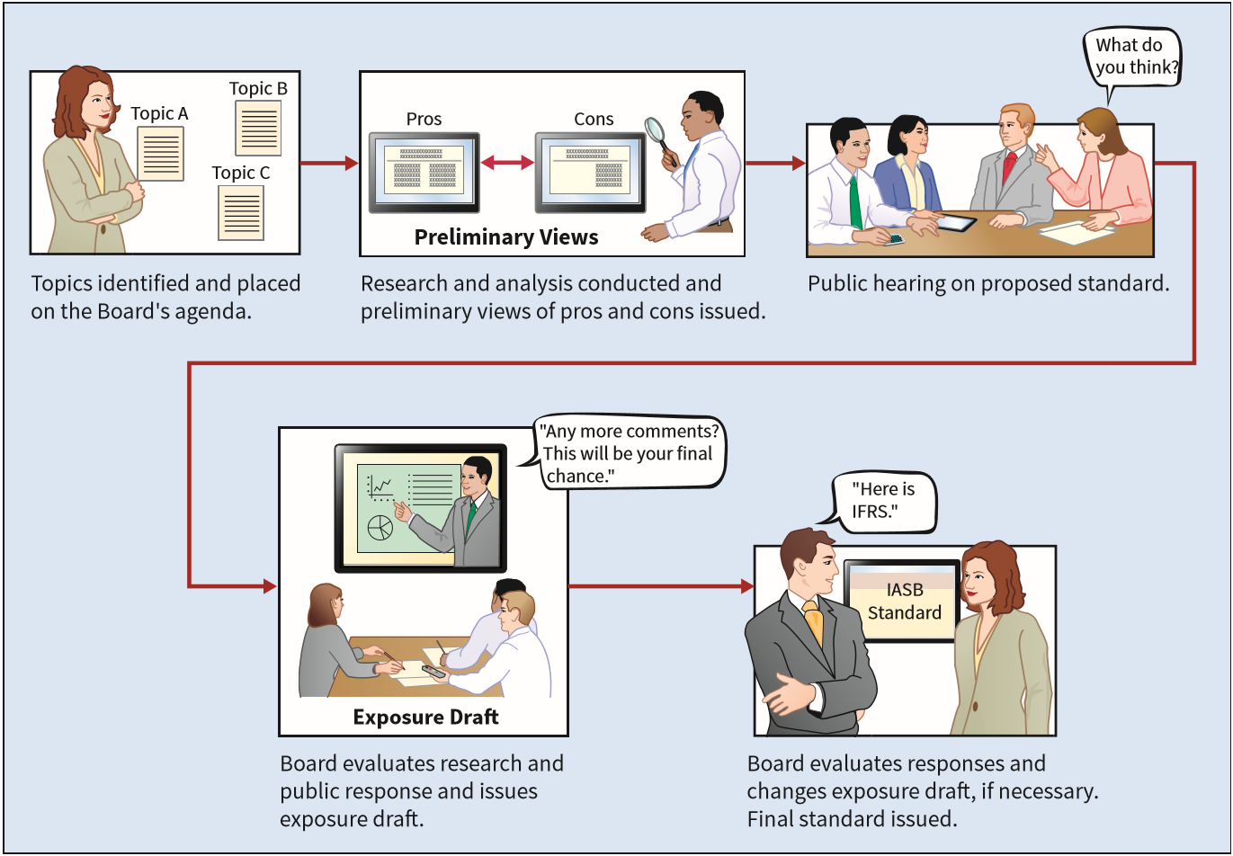
ILLUSTRATION 1.5
International Standard-Setting Structure
LO 3

Slide 30

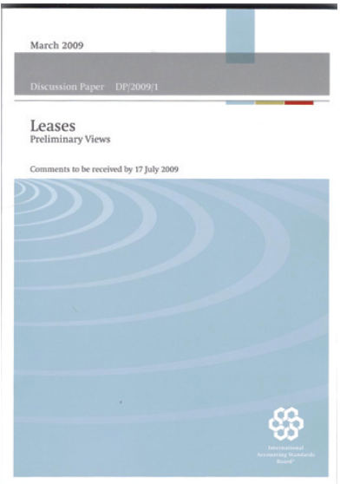
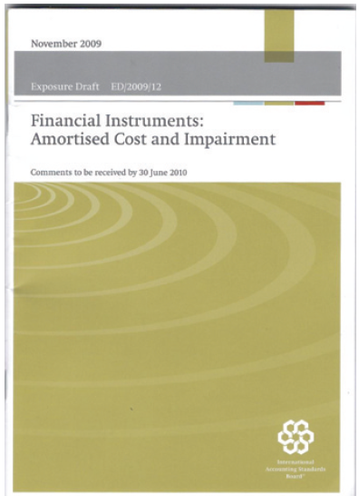
International Accounting Standards Board
Types of Pronouncements
International Financial Reporting Standards.
Conceptual Framework for Financial Reporting.
International Financial Reporting Standards Interpretations.
LO 3
Notes:
Financial accounting standards issued by the IASB are referred to as International Financial Reporting Standards (IFRS).
This Conceptual Framework for Financial Reporting sets forth the fundamental objective and concepts that the Board uses in developing future standards of financial reporting.
Interpretations issued by the IFRS Interpretations Committee are also considered authoritative and must be followed. These interpretations cover (1) newly identified financial reporting issues not specifically dealt with in IFRS and (2) issues where unsatisfactory or conflicting interpretations have developed, or seem likely to develop, in the absence of authoritative guidance.

Slide 31
Standard-Setting Organizations
Hierarchy of IFRS
Companies first look to:
International Financial Reporting Standards; International Financial Reporting Standards, International Accounting Standards (issued by the predecessor to the IASB), and IFRS interpretations originated by the IFRS Interpretations Committee (and its predecessor, the IAS Interpretations Committee);
The Conceptual Framework for Financial Reporting; and
Pronouncements of other standard-setting bodies that use a similar conceptual framework (e.g., U.S. GAAP).
LO 3
Notes:
Any company indicating that it is preparing its financial statements in conformity with IFRS must use all of the standards and interpretations. The following hierarchy is used to determine what recognition, valuation, and disclosure requirements should be used.

Slide 32
LEARNING OBJECTIVES
CHAPTER 2
Conceptual Framework for Financial Reporting
After studying this chapter, you should be able to:
Describe the usefulness of a conceptual framework and the objective of financial reporting.
Identify the qualitative characteristics of accounting information and the basic elements of financial statements.
Review the basic assumptions of accounting.
Explain the application of the basic principles of accounting.

Slide 33
Describe the usefulness of a conceptual framework and the objective of financial reporting.
Learning Objective 1

Slide 34
Conceptual Framework
Conceptual Framework establishes the concepts that underlie financial reporting.
Need for a Conceptual Framework
Rule-making should build on and relate to an established body of concepts.
Enables IASB to issue more useful and consistent pronouncements over time.
The profession should be able to more quickly solve new and emerging practical problems by referring to an existing framework of basic theory.
LO 1
Notes:
A soundly developed conceptual framework thus enables the IASB to issue more useful and consistent pronouncements over time, and a coherent set of standards should result.
Second, as a result of a soundly developed conceptual framework, the profession should be able to more quickly solve new and emerging practical problems by referring to an existing framework of basic theory.

Slide 35
Conceptual Framework
Overview of the Conceptual Framework
Three levels:
First Level = Objectives of Financial Reporting
Second Level = Qualitative Characteristics and Elements of Financial Statements
Third Level = Recognition, Measurement, and Disclosure Concepts.
LO 1

Slide 36
ASSUMPTIONS
Economic entity
Going concern
Monetary unit
Periodicity
Accrual
PRINCIPLES
Measurement
Revenue recognition
Expense recognition
Full disclosure
CONSTRAINTS
Cost
Third level
The "how"—
implementation
QUALITATIVE CHARACTERISTICS
Fundamental qualities
Enhancing qualities
ELEMENTS
Assets
Liabilities
Equity
Income
Expenses
Second level
Bridge between
levels 1 and 3
OBJECTIVE
Provide information about the reporting
entity that is useful
to present and potential
equity investors,
lenders, and other
creditors in their
capacity as capital
providers.
First level
The "why"—purpose
of accounting
ILLUSTRATION 2.7 Conceptual Framework for Financial Reporting

Slide 37
Basic Objective
Objective: Provide financial information about the reporting entity that is useful to
present and potential equity investors,
lenders, and
other creditors
in making decisions about providing resources to the entity.
LO 1
Notes:
An implicit assumption is that users need reasonable knowledge of business and financial accounting matters to understand the information contained in financial statements. This means that financial statement preparers assume a level of competence on the part of users, which impacts the way and the extent to which companies report information.

Slide 38
Objective of Financial Reporting
General-Purpose Financial Statements
Provide financial reporting information to a wide variety of users.
Provide the most useful information possible at the least cost.
Equity Investors and Creditors
Investors and creditors are the primary user group.
LO 2

Slide 39
Objective of Financial Reporting
Entity Perspective
Companies viewed as separate and distinct from their owners (shareholders).
Decision-Usefulness
Investors are interested in assessing
the company’s ability to generate net cash inflows and
management’s ability to protect and enhance the capital providers’ investments.
LO 2
Notes:
Those decisions involve buying, selling, or holding equity and debt instruments, and providing or settling loans and other forms of credit. To make effective decisions, these parties need information to help them assess a company’s prospects for future net cash flows and/or provide a return to existing and potential investors, lenders, and other creditors.
Management stewardship [ˈstuərdˌʃɪp] is how well management uses a company’s resources to create and sustain value. To evaluate stewardship, companies should provide information about their financial position, changes in financial position, and performance. They should also show how efficiently and effectively management and the board of directors have discharged their responsibilities to use the company’s resources wisely. Therefore, information that is useful in assessing stewardship can also be useful for assessing a company’s prospects for future net cash inflows.

Slide 40
单选题
1分
Question
The objective of financial reporting places most emphasis on:
A
reporting to capital providers.
B
reporting on stewardship.
C
providing specific guidance related to specific needs.
D
providing information to individuals who are experts in the field.
Submit

Slide 41
单选题
1分
Question
General-purpose financial statements are prepared primarily for:
A
internal users.
B
external users.
C
auditors.
D
government regulators.
Submit

Slide 42
Identify the qualitative characteristics of accounting information and the elements of financial statements.
Learning Objective 2

Slide 43
Fundamental Concepts
Qualitative Characteristics of Accounting Information
IASB identified the Qualitative Characteristics of accounting information that distinguish better (more useful) information from inferior (less useful) information for decision-making purposes.
LO 2

Slide 44
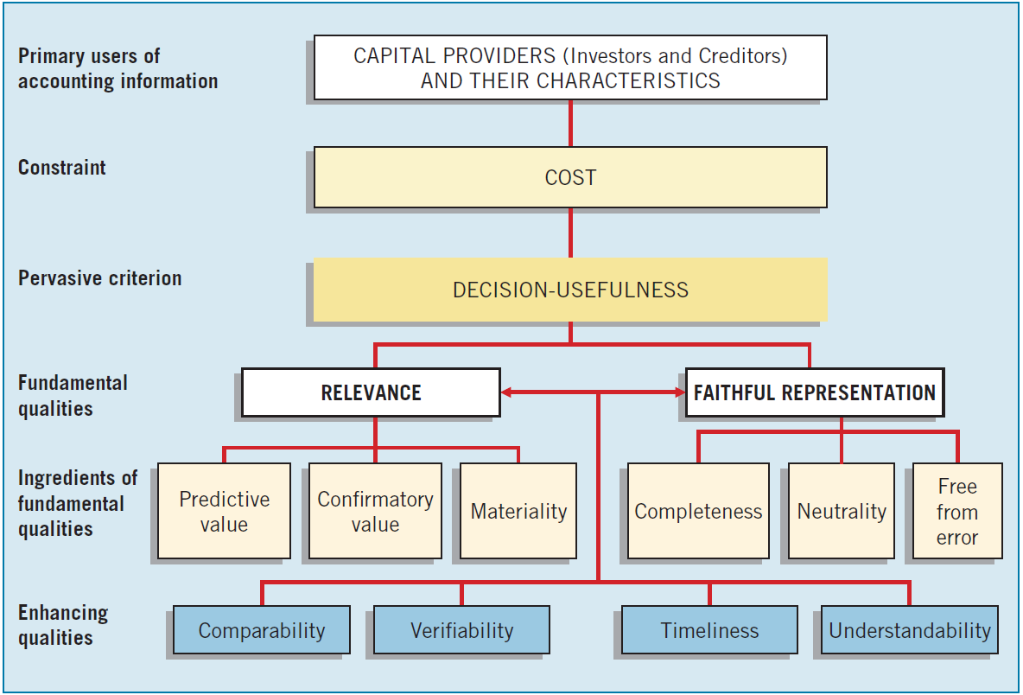
Hierarchy of Accounting Qualities
ILLUSTRATION 2.2 Hierarchy of Accounting Qualities
LO 2
Notes:
How does a company choose an acceptable accounting method, the amount and types of information to disclose, and the format in which to present it? The answer: By determining which alternative provides the most useful information for decision-making purposes (decision-usefulness).

Slide 45
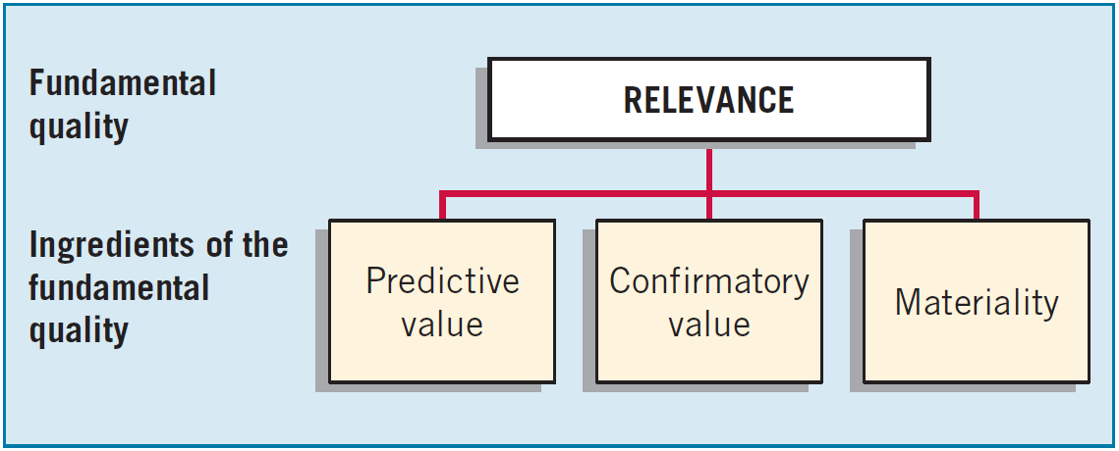
Qualitative Characteristics
Fundamental Quality—Relevance
To be relevant, accounting information must be capable of making a difference in a decision.
LO 2
Notes:
Information with no bearing on a decision is irrelevant. Financial information is capable of making a difference when it has predictive value, confirmatory value, or both.

Slide 46
Qualitative Characteristics
Fundamental Quality—Relevance
Financial information has predictive value if it has value as an input to predictive processes used by investors to form their own expectations about the future.
LO 2
Notes:
For example, if potential investors are interested in purchasing ordinary shares in Nippon (JPN), they may analyze its current resources and claims to those resources, its dividend payments, and its past income performance to predict the amount, timing, and uncertainty of Nippon’s future cash flows

Slide 47
Qualitative Characteristics
Fundamental Quality—Relevance
Relevant information also helps users confirm or correct prior expectations.
LO 2
Notes:
Nippon issues its year-end financial statements, it confirms or changes past (or present) expectations based on previous evaluations.

Slide 48
Qualitative Characteristics
Fundamental Quality—Relevance
Information is material if omitting it or misstating it could influence decisions that users make on the basis of the reported financial information.
LO 2
Notes:
Materiality: Materiality is a company-specific aspect of relevance. Information is material if omitting or misstating would make a difference in users’ decisions. It requires evaluating both the relative size and importance of an item. While companies and auditors adopt a general rule of thumb is that anything under 5 percent of net income is considered immaterial, this depends upon specific rules;
For example, companies can no longer fail to record items in order to meet consensus analysts’ earnings numbers, preserve a positive earnings trend, convert a loss to a profit or vice versa, increase management compensation, or hide an illegal transaction like a bribe.
companies must consider both quantitative and qualitative factors when determining materiality thresholds.

Slide 49
Materiality
Brief Exercise 2.11 : Determine whether you would classify these transactions as material.
Blair Co. has reported a positive trend in earnings over the last 3 years. In the current year, it reduces its bad debt expense to ensure another positive earnings year. The impact of this adjustment is equal to 3% of net income.
Hindi SE has a gain of €3.1 million on the sale of plant assets and a €3.3 million loss on the sale of investments. It decides to net the gain and loss because the net eﬀect is considered immaterial. Hindi SE’s income for the current year was €10 million.
LO 4

Slide 50
Materiality
Brief Exercise 2.11 : Determine whether you would classify these transactions as material.
Damon SpA expenses all capital equipment under €2,500 on the basis that it is immaterial. The company has followed this practice for a number of years.
LO 4

Slide 51
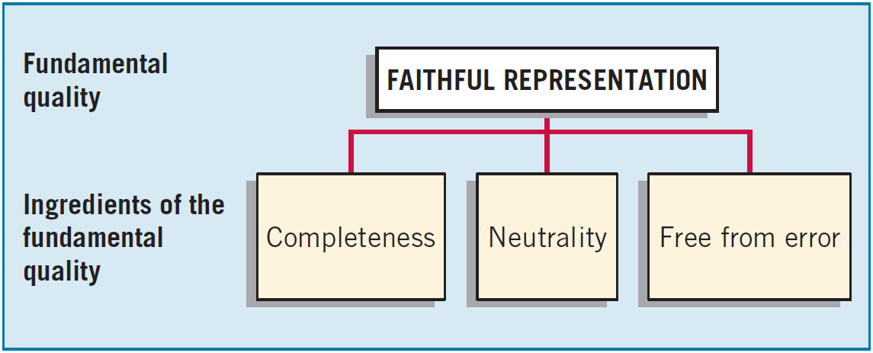
Qualitative Characteristics
Fundamental Quality—Faithful Representation
Faithful representation means that the numbers and descriptions match what really existed or happened.
LO 2
Notes:
To be a faithful representation, information must be complete, neutral, and free of material error.

Slide 52
Qualitative Characteristics
Fundamental Quality—Faithful Representation
Completeness means that all the information that is necessary for faithful representation is provided.
LO 2
Notes:
An omission can cause information to be false or misleading and thus not be helpful to the users of financial reports. For example, when Société Générale (FRA) fails to provide information needed to assess the value of its subprime loan receivables (toxic assets), the information is not complete and therefore not a faithful representation of the value of the receivable.

Slide 53
Qualitative Characteristics
Fundamental Quality—Faithful Representation
Neutrality means that a company cannot select information to favor one set of interested parties over another.
LO 2
Notes:
Providing neutral or unbiased information must be the overriding consideration. For example, in the notes to financial statements, tobacco companies such as British American Tobacco (GBR) should not suppress information about the numerous lawsuits that have been filed because of tobacco-related health concerns—even though such disclosure is damaging to the company.
The IASB indicates that neutrality is supported by prudence. Prudence is the exercise of caution when making judgments under conditions of uncertainty. That is, the exercise of prudence means that assets and income are not overstated, and liabilities and expenses are not understated.

Slide 54
Qualitative Characteristics
Fundamental Quality—Faithful Representation
An information item that is free from error will be a more accurate (faithful) representation of a financial item.
LO 2
Notes:
Does not mean total freedom from error. It means that the information presented is as accurate as possible, given that any estimates are based on the best information available at the time.
For example, if UBS (CHE) misstates its loan losses, its financial statements are misleading and not a faithful representation of its financial results.
However, faithful representation does not imply total freedom from error. This is because most financial reporting measures involve estimates of various types that incorporate management’s judgment. For example, management must estimate the amount of uncollectible accounts to determine bad debt expense. And determination of depreciation expense requires estimation of useful lives of plant and equipment, as well as the residual value of the assets.

Slide 55
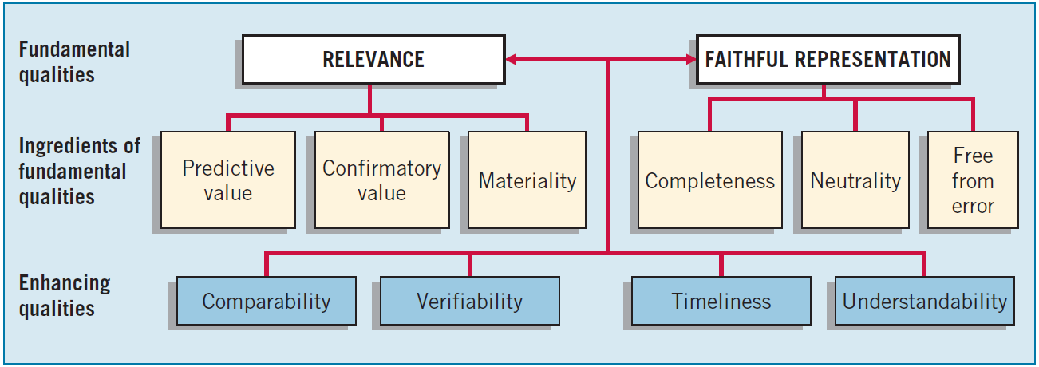
Qualitative Characteristics
Enhancing Qualities
Enhancing qualitative characteristics are complementary to the fundamental qualitative characteristics.
LO 2

Slide 56
Qualitative Characteristics
Enhancing Qualities
Information that is measured and reported in a similar manner for different companies is considered comparable.
LO 2
Notes:
com‧pa‧ra‧ble /ˈkɒmpərəbəl $ ˈkɑːm-/
Information that is measured and reported similarly for different companies is considered comparable. It enables users to identify the real similarities and differences in economic events between companies.
Another type of comparability is consistency, which is present when a company applies the same accounting treatment to similar events, from period to period

Slide 57
Qualitative Characteristics
Enhancing Qualities
Verifiability means different knowledgeable and independent observers could reach consensus.
LO 2
Notes:
Two independent auditors count Tata Motors’ (IND) inventory and arrive at the same physical quantity amount for inventory. Verification of an amount for an asset therefore can occur by simply counting the inventory (referred to as direct verification).
Two independent auditors compute Tata Motors’ inventory value at the end of the year using the FIFO method of inventory valuation. Verification may occur by checking the inputs (quantity and costs) and recalculating the outputs (ending inventory value) using the same accounting convention or methodology (referred to as indirect verification).

Slide 58
Qualitative Characteristics
Enhancing Qualities
Timeliness means having information available to decision-makers before it loses its capacity to influence decisions.
LO 2
Notes:
Having relevant information available sooner can enhance its capacity to influence decisions, and a lack of timeliness can rob information of its usefulness. For example, if Lenovo Group (CHN) waited to report its interim results until nine months after the period, the information would be much less useful for decision-making purposes.

Slide 59
Qualitative Characteristics
Enhancing Qualities
Understandability is the quality of information that lets reasonably informed users see its significance.
LO 2
Notes:
Is the quality of information that lets reasonably informed users see the connection between their decisions and the information contained in the financial statements.
Understandability is enhanced when information is classified, characterized, and presented clearly and concisely

Slide 60
Basic Elements
Elements of Financial Statements
Asset
A present economic resource controlled by the entity as a result of past events. An economic resource is a right with the potential to produce economic benefits.
Liability
Equity
Income
Expenses
LO 2
Notes:
Give some examples for each element? Ask student.

Slide 61
Basic Elements
Elements of Financial Statements
Asset
A present obligation of the entity to transfer an economic resource as a result of past events.
Liability
Equity
Income
Expenses
LO 2

Slide 62
Basic Elements
Elements of Financial Statements
Asset
Liability
Equity
The residual interest in the assets of the entity after deducting all its liabilities.
Income
Expenses
LO 2

Slide 63
Basic Elements
Elements of Financial Statements
Asset
Liability
Equity
Increases in assets, or decreases in liabilities, that result in increases in equity, other than those relating to contributions from holders of equity claims.
Income
Expenses
LO 2

Slide 64
Basic Elements
Elements of Financial Statements
Asset
Liability
Equity
Income
Decreases in assets, or increases in liabilities, that result in decreases in equity, other than those relating to distributions to holders of equity claims.
Expenses
LO 2
Notes:
As indicated, the IASB classifies the elements into two distinct groups. [8]
The first group of three elements—assets, liabilities, and equity—describes amounts of resources and claims to resources at a moment in time.
The second group of two elements describes transactions, events, and circumstances that affect a company during a period of time.

Slide 65
Basic Elements
Exercise 2.4: Identify the qualitative characteristic(s) to be used given the information provided.
Characteristics
Qualitative characteristic being displayed when companies in the same industry are using the same accounting principles.
Quality of information that confirms users’ earlier expectations.
Imperative for providing comparisons of a company from period to period.
Ignores the economic consequences of a standard or rule.
Relevance
Faithful representation
Predictive value
Confirmatory value
Neutrality
Materiality
Timeliness
Verifiability
Understandability
Comparability
LO 2

Slide 66
Basic Elements
Exercise 2.4: Identify the qualitative characteristic(s) to be used given the information provided.
Characteristics
Requires a high degree of consensus among individuals on a given measurement.
Predictive value is an ingredient of this fundamental quality of information.
Four qualitative characteristics that enhance both relevance and faithful representation.
An item is not reported because its effect on income would not change a decision.
Relevance
Faithful representation
Predictive value
Confirmatory value
Neutrality
Materiality
Timeliness
Verifiability
Understandability
Comparability
LO 2

Slide 67
Basic Elements
Exercise 2.4: Identify the qualitative characteristic(s) to be used given the information provided.
Characteristics
Neutrality is a key ingredient of this fundamental quality of accounting information.
Two fundamental qualities that make accounting information useful for decision-making purposes.
Issuance of interim reports is an example of what enhancing ingredient?
Relevance
Faithful representation
Predictive value
Confirmatory value
Neutrality
Materiality
Timeliness
Verifiability
Understandability
Comparability
LO 2

Slide 68
Review the basic assumptions of accounting.
Learning Objective 3

Slide 69
Recognition, Measurement, and Disclosure Concepts
These concepts explain how companies should recognize, measure, and report financial elements and events.
Recognition, Measurement, and Disclosure Concepts
ASSUMPTIONS
Economic entity
Going concern
Monetary unit
Periodicity
Accrual
PRINCIPLES
Measurement
Revenue recognition
Expense recognition
Full disclosure
CONSTRAINTS
Cost
ILLUSTRATION 2.7
Conceptual Framework for Financial Reporting
LO 3

Slide 70
Assumptions
Economic Entity – company keeps its activity separate from its owners and other business unit.
Going Concern - company to last long enough to fulfill objectives and commitments.
Monetary Unit - money is the common denominator.
Periodicity - company can divide its economic activities into time periods.
Accrual Basis of Accounting – transactions are recorded in the periods in which the events occur.
LO 3
Notes:
Thus, the entity concept does not necessarily refer to a legal entity. A parent company and its subsidiaries are separate legal entities, but merging their activities for accounting and reporting purposes does not violate the economic entity assumption。
Going concern: This assumption has significant implications. The historical cost principle would be of limited usefulness if we assumed eventual liquidation. Under a liquidation approach, for example, a company would better state asset values at fair value than at acquisition cost.
The monetary unit assumption means that money is the common denominator of economic activity and provides an appropriate basis for accounting measurement and analysis.
The periodicity (or time period) assumption implies that a company can divide its economic activities into artificial time periods. These time periods vary, but the most common are monthly, quarterly, and yearly.
For example, using the accrual basis means that companies recognize revenues when they satisfy a performance obligation (the revenue recognition principle). This is in contrast to recognition based on receipt of cash. Likewise, under the accrual basis, companies recognize expenses when incurred (the expense recognition principle) rather than when paid.
Under cash-basis accounting, companies record revenue only when cash is received. They record expenses only when cash is paid.

Slide 71
Assumptions
Brief Exercise 2.8: Identify which basic assumption of accounting is best described in each item below.
The economic activities of FedEx Corporation (USA) are divided into 12-month periods for the purpose of issuing annual reports.
Total S.A. (FRA) does not adjust amounts in its financial statements for the effects of inflation.
Barclays (GBR) reports current and non-current classifications in its statement of financial position.
The economic activities of Tokai Rubber Industries (JPN) and its subsidiaries are merged for accounting and reporting purposes.
LO 3

Slide 72
Explain the application of the basic principles of accounting.
Learning Objective 4

Slide 73
Basic Principles of Accounting
Measurement Principles
Historical Cost is generally thought to be a faithful representation of the amount paid for a given item.
Current Value
Fair value is defined as “the price that would be received to sell an asset or paid to transfer a liability in an orderly transaction between market participants at the measurement date.”
IASB has given companies the option to use fair value as the basis for measurement of financial assets and financial liabilities.
LO 4
Notes:
IFRS requires that companies account for and report many assets and liabilities on the basis of acquisition price. This is often referred to as the historical cost principle.
Cost has an important advantage over other valuations: It is generally thought to be a faithful representation of the amount paid for a given item.

Slide 74
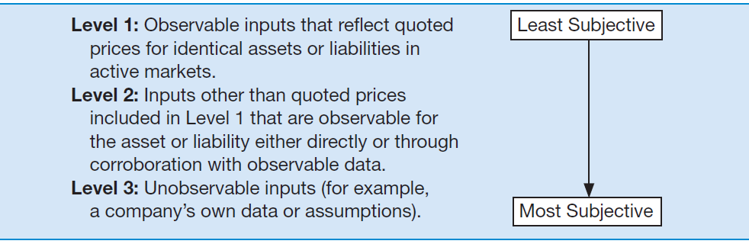
Basic Principles of Accounting
Measurement Principles
IASB established a fair value hierarchy that provides insight into the priority of valuation techniques to use to determine fair value.
ILLUSTRATION 2.4
LO 4

Slide 75
Basic Principles of Accounting
Measurement Principles
Current Value
Value in use for assets and fulfillment value for liabilities.
Value in use is the present value of the cash flows, or other economic benefits that a company expects to derive from the use of an asset and from its ultimate disposal.
Fulfillment value is the present value of the cash, or other economic resources that a company expects to be obliged to transfer as it fulfills a liability.
LO 4
Notes:
Value in use and fulfillment value cannot be observed directly and are determined using cash-flow-based measurement techniques. Value in use and fulfillment value reflect the same factors described for fair value but from a company-specific perspective rather than from a market-participant perspective.

Slide 76
Basic Principles of Accounting
Measurement Principles
Current Value
Current Cost
The current cost of an asset is the cost of an equivalent asset at the measurement date, comprising the consideration that would be paid at the measurement date plus the transaction costs that would be incurred at that date.
The current cost of a liability is the consideration that would be received for an equivalent liability at the measurement date minus the transaction costs that would be incurred at that date.
LO 4
Notes:
Similar to historical cost, current cost is an entry value: It reflects prices in the market in which the company would acquire the asset or would incur the liability.
However, unlike historical cost, current cost reflects conditions at the measurement date.
Current cost frequently cannot be determined directly by observing prices in an active market and must be determined indirectly by other means. For example, if prices are available only for new assets, the current cost of a used asset might need to be estimated by adjusting the current price of a new asset to reflect the current age and condition of the asset held by the entity

Slide 77
Basic Principles of Accounting
Revenue Recognition Principle
When a company agrees to perform a service or sell a product to a customer, it has a performance obligation.
Requires that companies recognize revenue in the accounting period in which the performance obligation is satisfied.
LO 4
Notes:
Recognition is the process of capturing for inclusion in the statement of financial position or the statement(s) of financial performance an item that meets the definition of one of the elements of financial statements

Slide 78
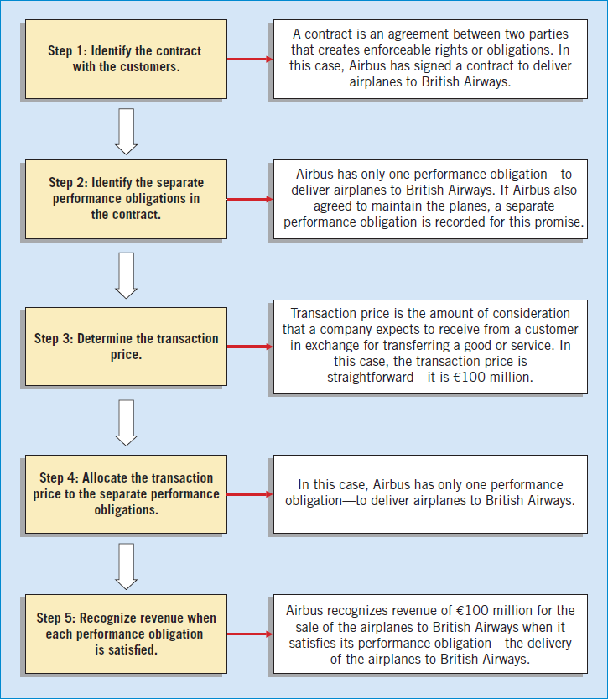
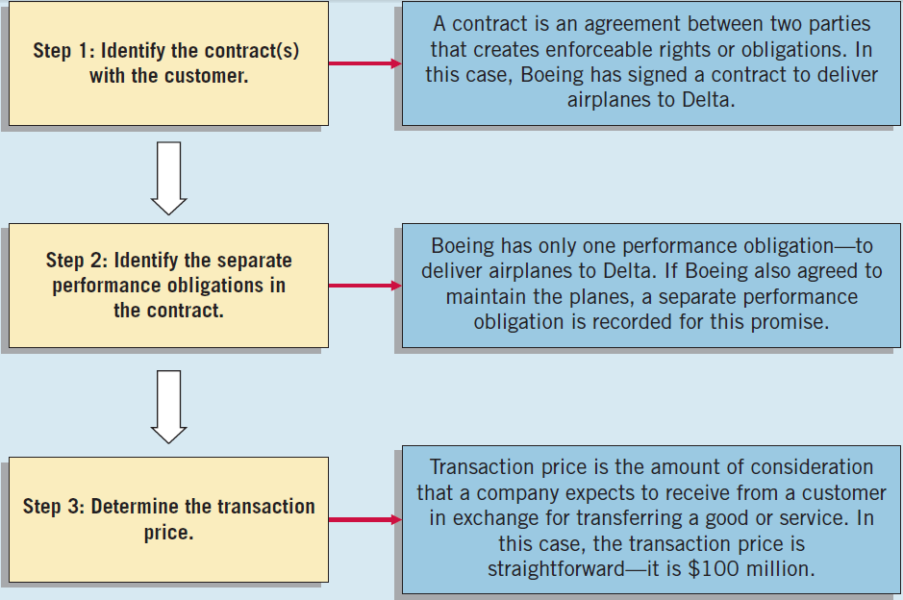
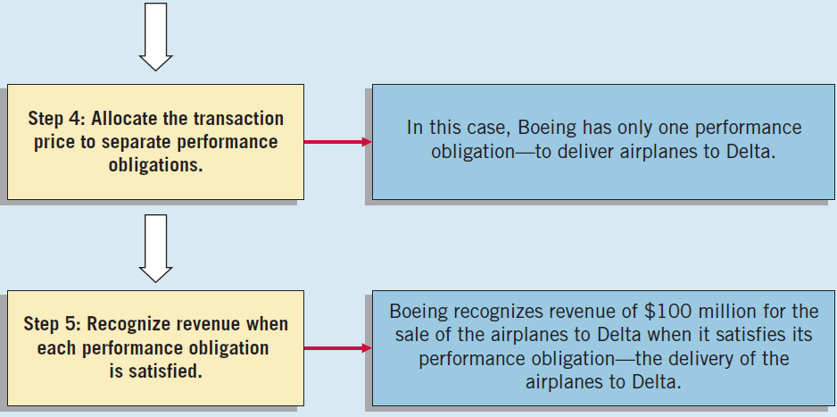
Basic Principles of Accounting
Illustration: Assume the Airbus (DEU) signs a contract to sell airplanes to British Airways (GRB) for €100 million. To determine when to recognize revenue, Airbus uses the five steps for revenue recognition shown at right.
ILLUSTRATION 2.5
The Five Steps of Revenue Recognition
Notes:
To illustrate, assume that Klinke Cleaners cleans clothing on June 30 but customers do not claim and pay for their clothes until the first week of July. Klinke should record revenue in June when it performed the service (satisfied the performance obligation) rather than in July when it received the cash.

Slide 79
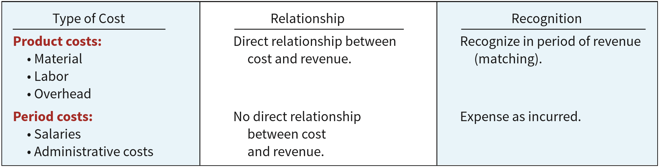
Basic Principles of Accounting
Expense Recognition - Outflows or “using up” of assets or incurring of liabilities during a period as a result of delivering or producing goods and/or rendering services.
ILLUSTRATION 2.6
Expense Recognition Procedures for Product and Period Costs
LO 4
Notes:
In practice, the approach for recognizing expenses is, “Let the expense follow the revenues.” This approach is the expense recognition principle.
Some costs, however, are difficult to associate with revenue. As a result, some other approach must be developed. Often, companies use a “rational and systematic” allocation policy to apply the expense recognition principle. PPE
Companies charge some costs to the current period as expenses (or losses) simply because they cannot determine a connection with revenue.

Slide 80
Basic Principles of Accounting
Full Disclosure Principle
Providing information that is of sufficient importance to influence the judgment and decisions of an informed user.
Provided through:
Financial Statements
Notes to the Financial Statements
Supplementary information
LO 4
Notes:
full disclosure principle, this practice recognizes that the nature and amount of information included in financial reports reflects a series of judgmental trade-offs. These trade-offs strive for (1) sufficient detail to disclose matters that make a difference to users, yet (2) sufficient condensation to make the information understandable, keeping in mind costs of preparing and using it.

Slide 81
Basic Principles of Accounting
BE2-9: Identify which basic principle of accounting is best described in each item below.
(a) Parmalat (ITA) reports revenue in its income statement when it delivered goods instead of when the cash is collected.
(b) Google (USA) recognizes depreciation expense for a machine over the 2-year period during which that machine helps the company earn revenue.
(c) KC Corp. (USA) reports information about pending lawsuits in the notes to its financial statements.
(d) Fuji Film (JPN) reports land on its statement of financial position at the amount paid to acquire it, even though the estimated fair market value is greater.
LO 4

Slide 82
Cost Constraint
Companies must weigh the costs of providing the information against the benefits that can be derived from using it.
Rule-making bodies and governmental agencies use cost-benefit analysis before making final their informational requirements.
In order to justify requiring a particular measurement or disclosure, the benefits perceived to be derived from it must exceed the costs perceived to be associated with it.
LO 4

Slide 83

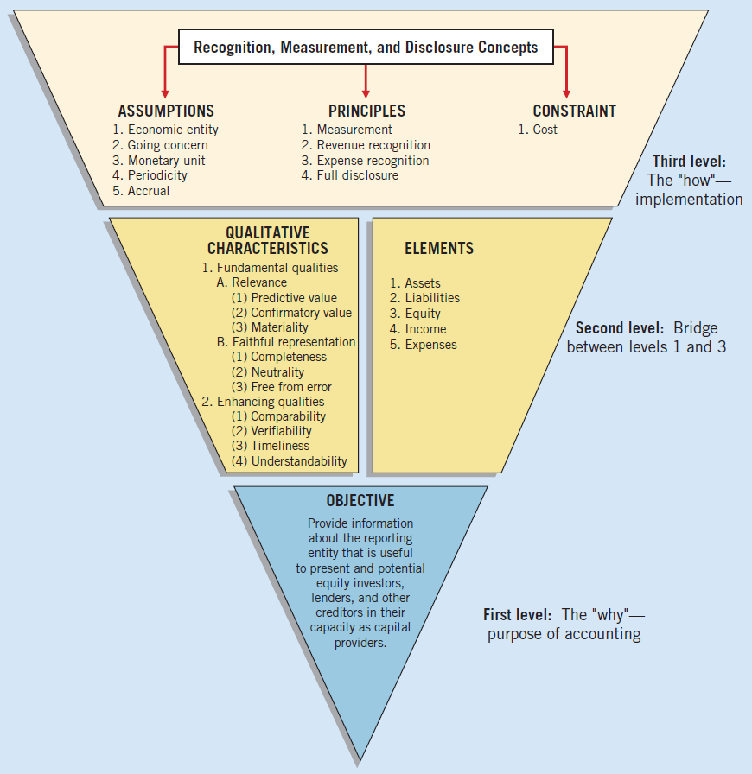
Summary of the Structure
ILLUSTRATION 2.7 Conceptual Framework for Financial Reporting
LO 2

